Slide 1
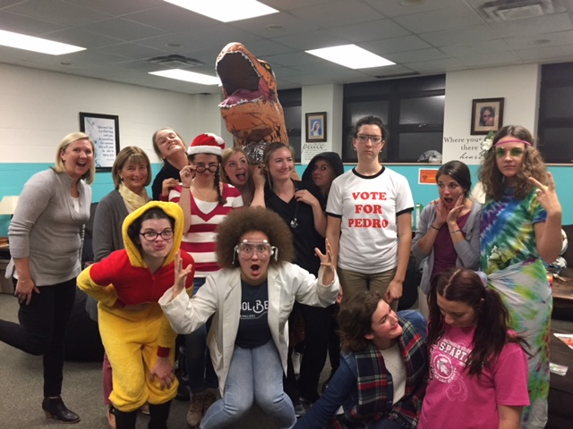
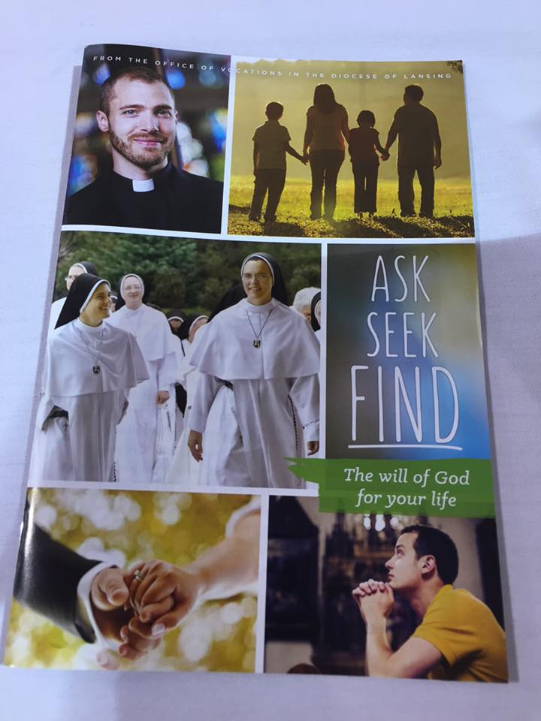
Accompanying Young People in Hearing God’s Voice
Notes:
Why is all of this important? 1) Discernment skills for life 2) Building a culture of Vocations 3) Community Dimension of discernment- not isolation/counter-cutural

Slide 2
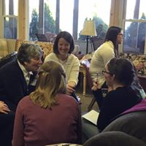
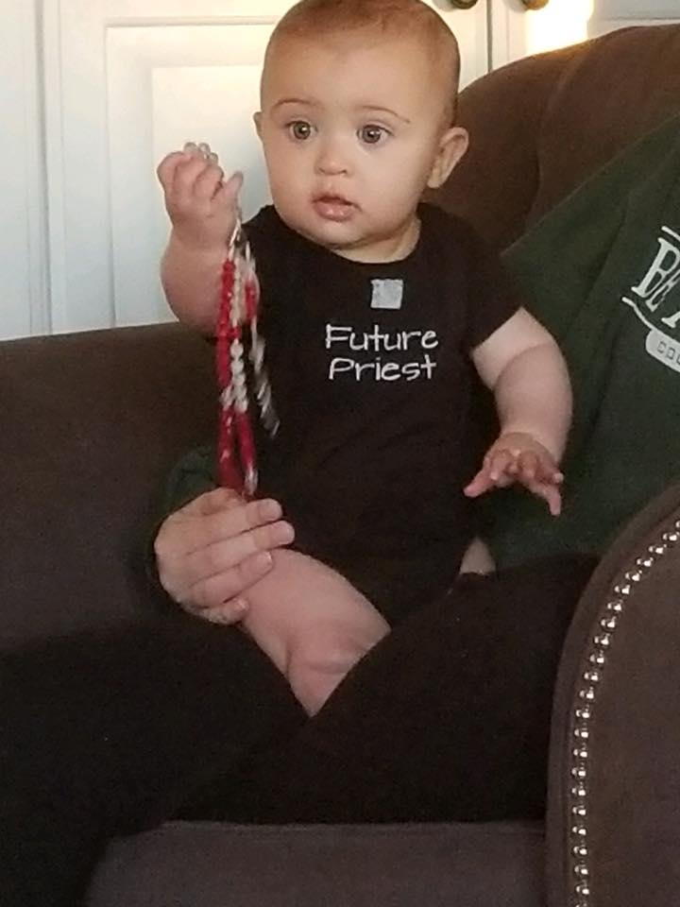
Shoulda, Coulda, Woulda… Fr. John
Accompanying Young People in Hearing God’s Voice
This workshop will entail how to build a culture of vocations in campus ministry programs, from discernment retreats & groups for men and women, to households of discernment & one-on-one mentoring. Fr. John and Dawn will share personal stories of working with college students in vocational discernment as well as a bit of their own journeys of hearing God’s call. They will also share some ‘dos and don’ts’ of this ministry too. The last part of the presentation will entail a practical application of discernment tools useful for your own life as well as those you serve.

Slide 3
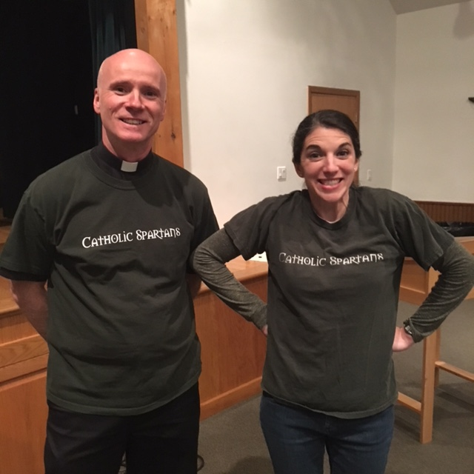
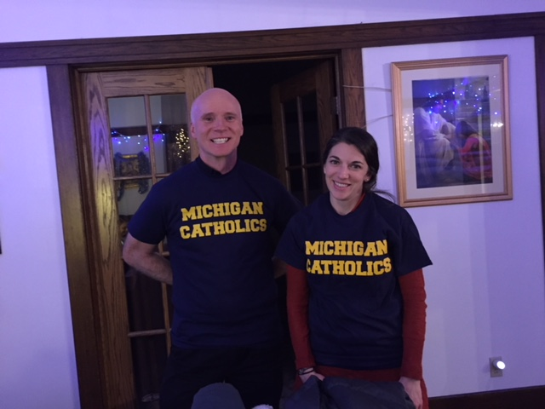
Where to begin…

Slide 4
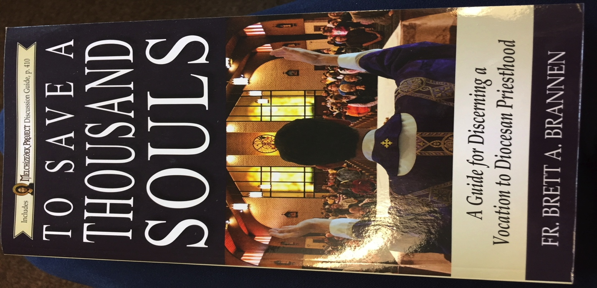
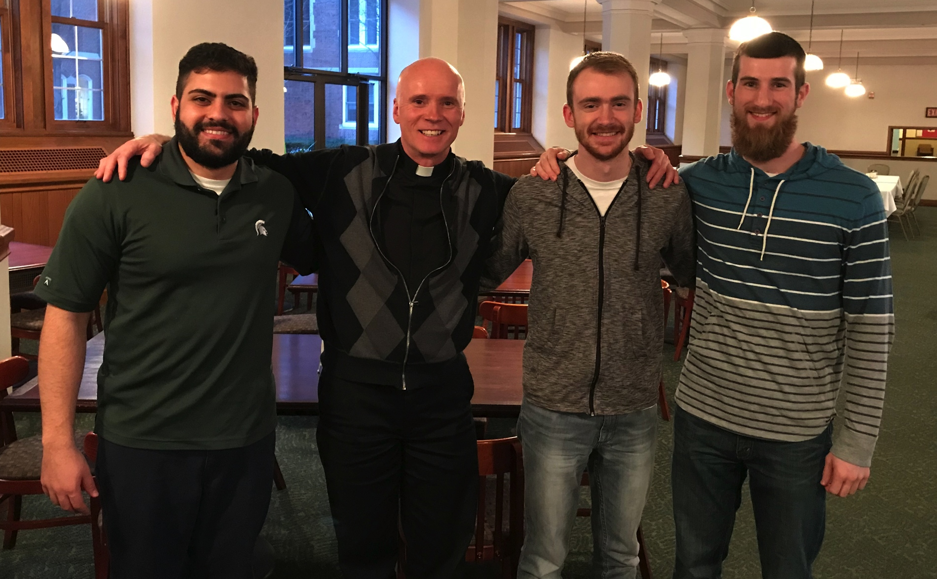
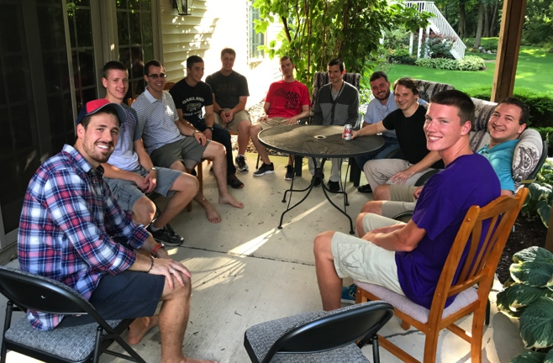
Men’s Discernment Groups

Slide 5
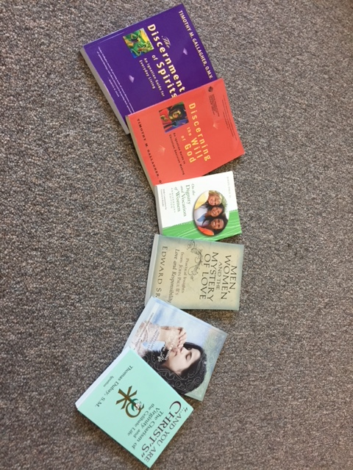
Women’s Discernment Groups

Slide 6
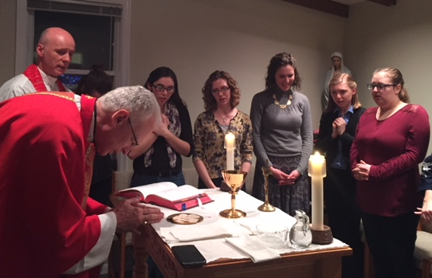
Emmaus House
Prayer & Mass
Community living
Formation
Service

Slide 7
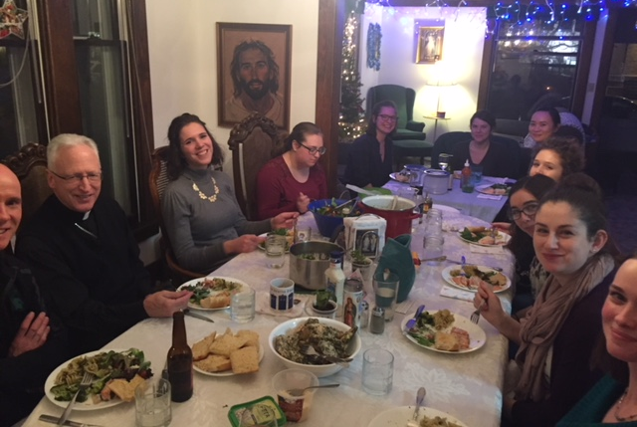
Emmaus Reunion

Slide 8
Discernment Retreats

Slide 9
“Come and See”

Slide 10
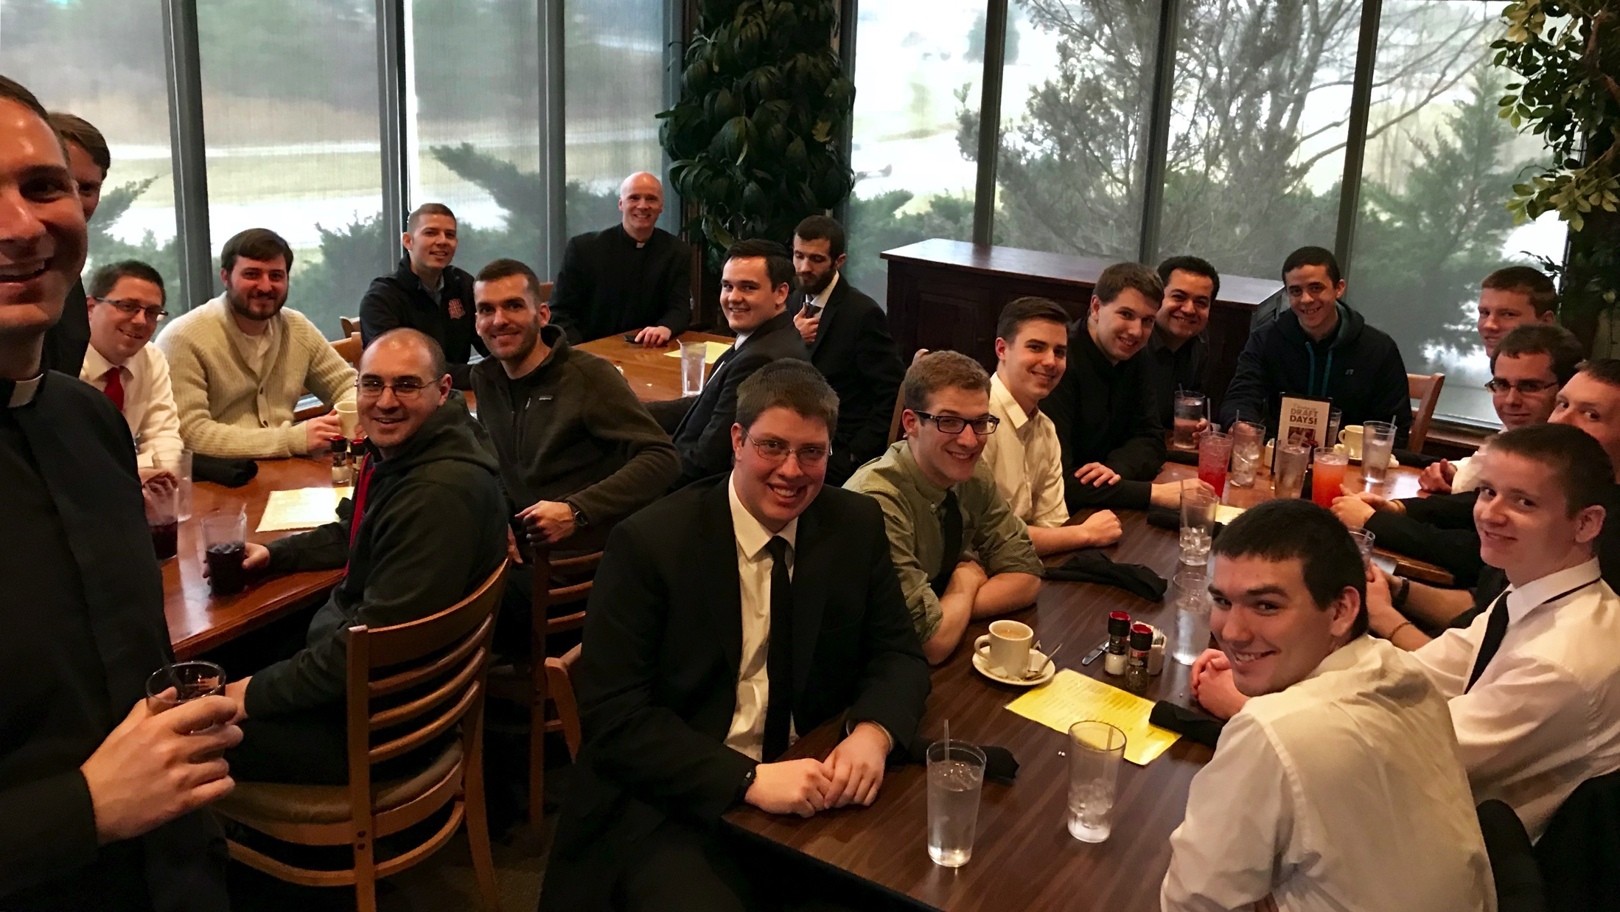
Seminary Visits

Slide 11
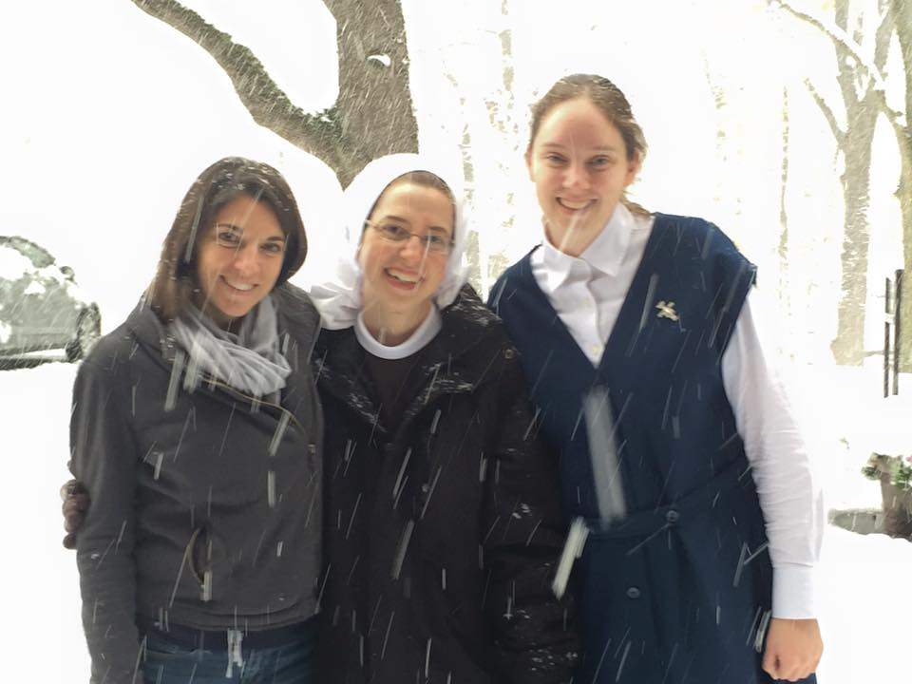
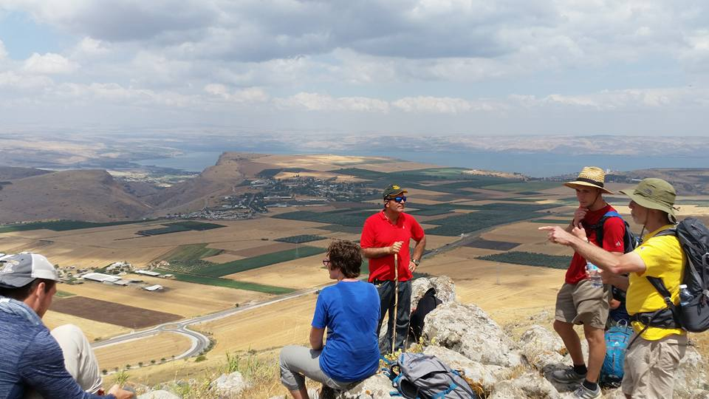
Direction One-on-One
College kiddos stories…

Slide 12
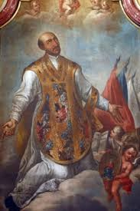
Discernment Tools, Ignatian-Style

